Slide 1
Prediction of Fraudulent Transaction

Slide 2
Contents for Discussion
Introduction
Understanding the Dataset
Preparation of the Dataset
Visualization
Checking Outliers
Balancing the Data
Models used
Results of classification models
Conclusion

Slide 3
METHOD I
In Method I, the dataset is imported directly from the internet. Basic EDA (Exploratory Data Analysis) can be taken place.
And then the process of feature selection can be done.
Feature selection includes three models namely Logistic Regression, Random Forest Classifier, and Decision Tree Classifier.

Slide 4
Introduction
Now-a-days, there are more number of fraudulent transactions are happening in our daily life.
To overcome the fradulants here the project will analysis the accuracy which helps to find out the fradulants rate and take further actions according to the report.
Let us move into our project for further understanding of the datasets.

Slide 5
Understanding of Dataset
First, we have to import the dataset from certain path, here we have imported the dataset from the weblink.
We have to analyse the dataset, what kind of the Data are present.
Here, our dataset contains both categorical values and numerical values.
Check the data types, name of the columns, size and shape of the Dataset.
And check the Description of the whole Dataset.

Slide 6
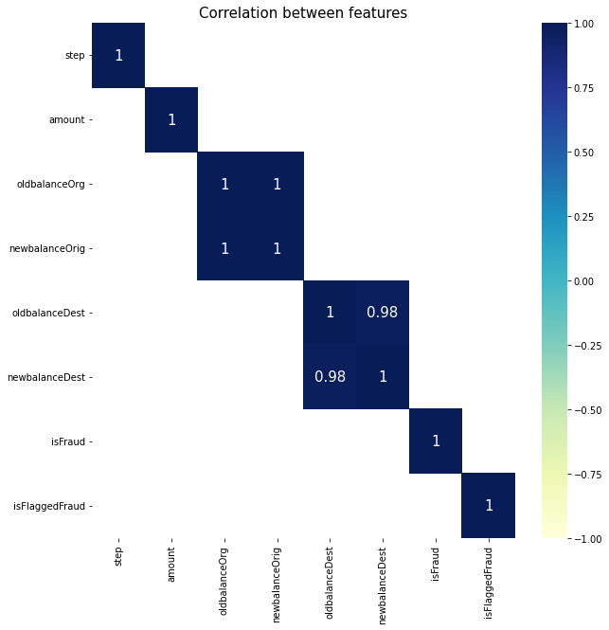
Preparation of the Dataset
During preparation of the dataset, we need to analyse the given Dataset whether it contains any duplicate values or missing values.
In our Dataset, there is no presence of the Duplicate values.
And there is no presence of missing values.
Correlation of the given dataset with specified columns are predicted.
The graph represents the Correlation between features.

Slide 7
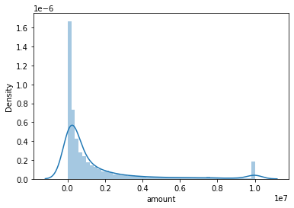
Visualization
The given Dataset can be visualized using Distplot, Boxplot, and Histogram.
Distplot represents the univariate distribution of the data.
The graph represents the data distribution of a variable against the density distribution.

Slide 8
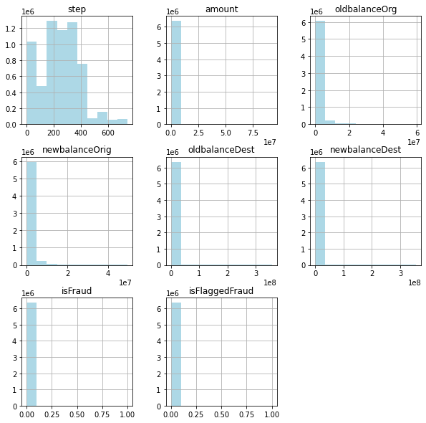
Visualization
Histogram is a graph showing frequency distributions.
This graph shows the number of observations within each given interval.

Slide 9
Checking Outliers
It is the process of identifying data point that have extreme values compared to rest of the data distribution.
Here, we are checking the outliers for only the required columns in our dataset.
Then we are using IQR (Inter Quantile Range) method.
After the execution of IQR method we are supposed to find that outliers are present in our dataset.
If we clip the outliers we cannot able to find out the fraudulent transactions.

Slide 10
Balancing the Data
In the prediction of fraudulent transactions, it is important to find whether the data is balanced or not.
In our dataset the given data is unbalanced.
For balancing the data we use SMOTE (Synthetic Minority Oversampling Technique).
The SMOTE analysis graph will be drawn as follows.

Slide 11
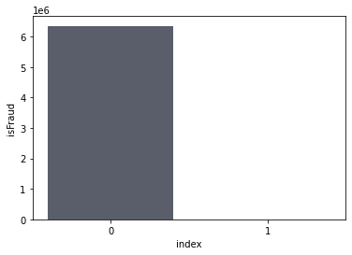
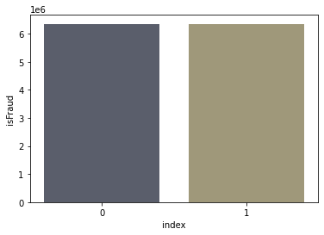
SMOTE
Before SMOTE Analysis
After SMOTE Analysis

Slide 12
Models Used
In this given dataset we have used classification models because we need to predict the fraudulent transactions.
Models that are used here are
1. Logistic Regression
2. Random Forest Classifier
3. Decision Tree Classifier

Slide 13
Results of Models
 | Model | AUC Score | Precision Score | Recall Score | Accuracy Score | f1-score
0 | Logistic_Regression | 0.935239 | 0.965599 | 0.902664 | 0.935225 | 0.933072
1 | RandomForestClassifier | 0.999632 | 0.999329 | 0.999935 | 0.999632 | 0.999632
2 | DecisionTreeClassifier | 0.999606 | 0.999432 | 0.999780 | 0.999606 | 0.999606
Here we are used Logistic_Regression, RandomForestClassifier and DecisionTreeClassifier,and the results can be viewed as mentioned above.

Slide 14
METHOD II
In Method II, the dataset is imported from the MYSQL workbench, where the interfacing of the MYSQL and Jupyter notebook takes place.
Here feature selection also takes place and then GridSearchCV can be used for the hyperparameter tuning for the Logistic Regression model.
And at last, Visualization of the dataset can be done using the POWER BI tool, which is also interfaced with the Jupyter notebook.

Slide 15
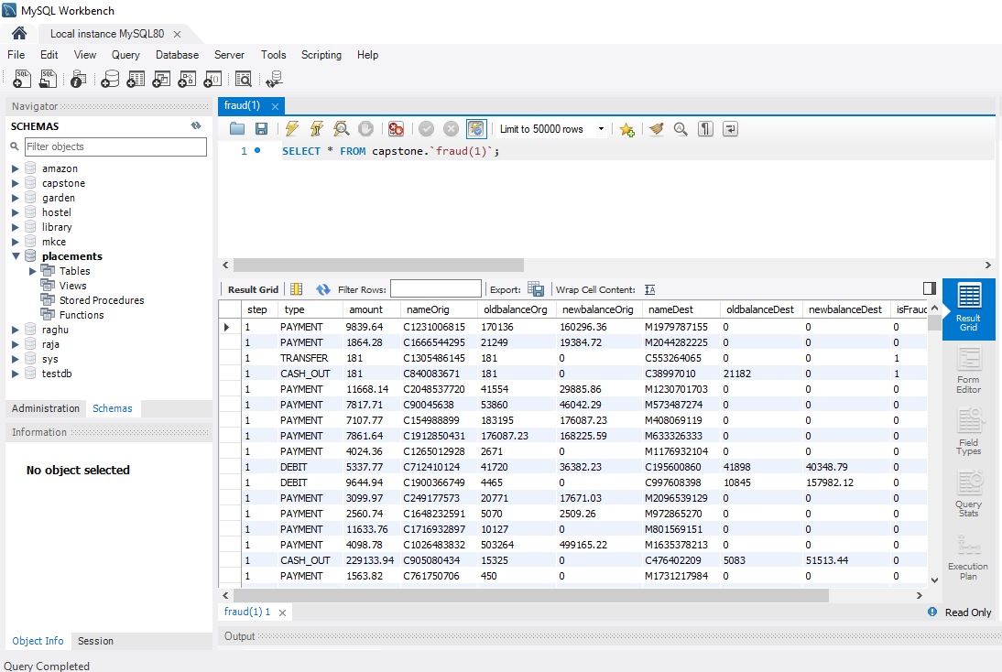
MYSQL Workbench

Slide 16
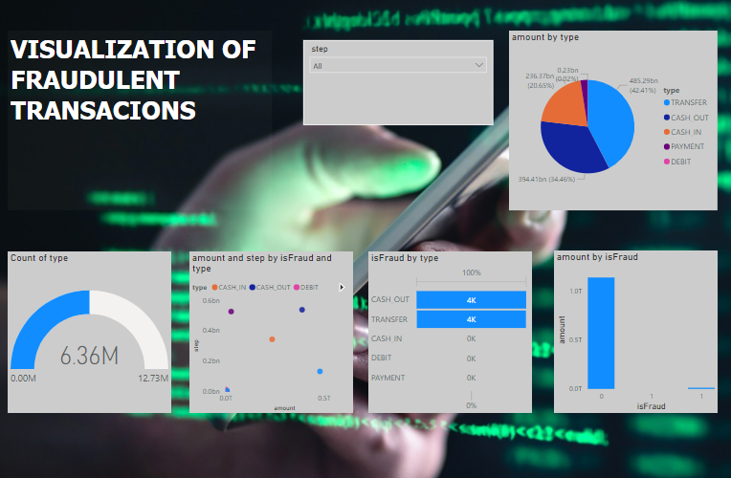
POWER BI

Slide 17
Conclusion
By implementing this model we can identify and manage those fraudlants and can create a better security for the account holders.
This process can be implemented in various banks and different branches, so that the trust by the customers will be increased.
In this prediction we have a better accuracy result with Decision Tree Classifier and Random Forest Classifier.

